Slide 1
FLIGHT INSTRUMENT
SYSTEMS
Gleim Chap. 2 & PHAK Chap. 8

Slide 2
FLIGHT INSTRUMENT SYSTEMS
Gyroscopic Flight Instruments
Attitude Indicator
Heading Indicator
Turn Indicator
Pitot-Static Instruments
Airspeed Indicator
Altimeter
Vertical Speed Indicator
Magnetic Compass

Slide 3
GYROSCOPIC
INSTRUMENTS
PHAK 8-15

Slide 4
Gyroscopic Flight Instruments
Attitude Indicator
Heading Indicator
Turn Indicator
Based on two fundamental concepts that apply to gyroscopes:
Rigidity in Space
Precession

Slide 5
Rigidity in Space
Refers to the principle that a wheel with a heavily weighted rim spun rapidly tends to remain fixed in the plane in which it is spinning
If a gyroscope is mounted on a set of gimbals, the gyro is able to rotate freely in any plane. The gyro will remain in the plane in which it is spinning regardless of any movement of the gimbals
A gyro tends to remain “rigid in space”

Slide 10
Precession
When an outside force is applied to a spinning gyro, the gyro responds as if the force had been applied at a point 90° further around in the direction of rotation
“Precedes” the effect by 90°
Unwanted precession is caused by friction in the gimbals and bearings of the instrument, causing a slow drifting in the heading indicator and occasional small errors in the attitude indicator

Slide 11
Force is applied here.
90°
Gyro responds as though force is applied here.

Slide 12
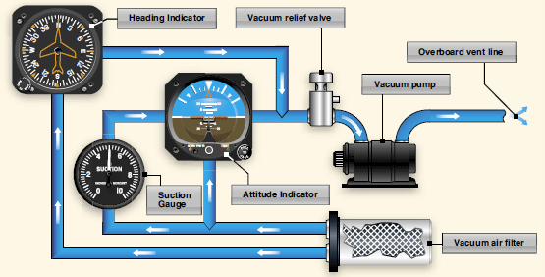
Typical Vacuum System
PHAK 8-17

Slide 13
ATTITUDE INDICATOR
PHAK 8-18

Slide 14
Attitude Indicator
Attitude indicator, or artificial horizon, is a mechanical substitute for the natural horizon
Gives you immediate and direct indication of the airplane’s pitch and bank attitude
In private pilot training, attitude indicator is integrated with outside visual references for precise control
During instrument training, attitude indicator becomes the central part of your scan without outside visual reference

Slide 15
Attitude Indicator
How it works…
A gyro which spins in the horizontal plane, mounted on dual gimbals that allow it to remain in that plane regardless of aircraft movement
The gyro spins in the horizontal plane
On a vacuum-driven or pressure-driven attitude indicator, pendulous vanes will cause the gyro to remain erect

Slide 16
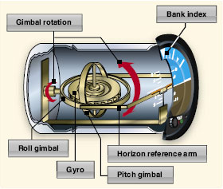

Slide 17
Attitude Indicator
Errors…
Usually very minor in modern indicators (less than 5° of bank error and 1 bar width of pitch error in a 180° turn)
Since gyro is parallel to the horizon, and the G-force inside the airplane is toward the bottom of the airplane (not gyro’s axis of rotation), the vanes open asymmetrically and cause the gyro to precess
Errors in both pitch and bank indication are usually at a maximum as the aircraft rolls out of a 180° turn. (Shows slight climb and a turn to the opposite direction)
During acceleration, the horizontal bar moves down, indicating a climb. Vice versa for deceleration

Slide 18
HEADING INDICATOR
N
33
3
30
6
W
E
24
12
21
15
S
PHAK 8-19

Slide 19
Heading Indicator
Required for IFR flights
Primary source of heading information
Check every 15 minutes for accuracy
Indirectly indicates bank (Secondary source of bank information)
How it works….
Senses rotation about the aircraft’s vertical axis
Some gyros are slaved to a magnetic compass. Does not have to be realigned manually if set to slaved mode.

Slide 20
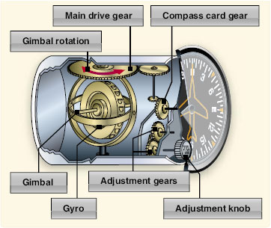

Slide 21
TURN COORDINATOR
TURN COORDINATOR
L
2 MIN.
R
PHAK 8-17

Slide 22
Turn Coordinator
Allows you to establish a standard-rate turn of 3° per second (360° turn in 2 minutes)
Senses both rate of roll and rate of turn
Turn coordinator gives indirect indication of bank
Electrically driven

Slide 23
Turn Coordinator
SLIP
TURN COORDINATOR
L
2 MIN.
R
CF
HCL

Slide 24
Turn Coordinator
SKID
TURN COORDINATOR
L
2 MIN.
R
CF
HCL

Slide 25
Turn Coordinator
COORDINATED
TURN COORDINATOR
L
2 MIN.
R
CF
HCL

Slide 26
MAGNETIC
COMPASS
PHAK 8-23

Slide 27
MAGNETIC COMPASS
FOR
N | 30 | 60 | E | 120 | 150
STEER
359 | 30 | 60 | 88 | 120 | 152
6
3
N

Slide 28
Magnetic Compass
Errors…
Variation
Deviation
Magnetic Dip
Oscillation
Northerly/Southerly Turning Errors
Acceleration/Deceleration Errors

Slide 29
Magnetic Compass
Variation
Angular difference between the true and magnetic poles
Deviation
Magnetic interference with metal components in the aircraft as well as magnetic field from electrical system
Magnetic Dip
Responsible for most significant compass errors
Because of the direction of the earth’s lines of magnetic force, magnetic dip is most pronounced near the poles and negligible near the equator
Oscillation
Due to erratic aircraft movement, compass will oscillate which makes it hard to read

Slide 30
When directly above the earth’s magnetic north pole, a magnet tries to point straight down, resulting in the greatest possible error from magnetic dip
N
S
At the equator, a magnet points more or less horizontally towards the earth’s magnetic north pole, and there is little error from magnetic dip

Slide 31
Magnetic Compass
Northerly/Southerly Turning Errors
Most apparent near poles and disappears as you approach the equator.
When entering a turn from a north heading, the compass will initially indicate a turn in the opposite direction.
UNOS (Undershoot North, Overshoot South)
Always roll out before you reach northerly heading.
Always roll out after you reach southerly heading.
Acceleration/Deceleration Errors
ANDS (Accelerate North, Decelerate South)
Compass swings towards north during acceleration.
Compass swings south during deceleration.

Slide 32
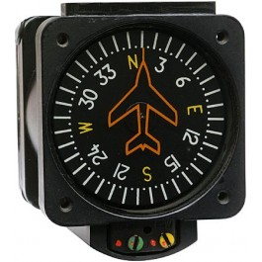
Vertical Card Compass

Slide 33
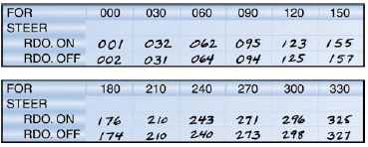
Compass Correction Card

Slide 34
PITOT-STATIC
INSTRUMENTS

Slide 35
Pitot-Static Instruments
Airspeed Indicator
Altimeter
Vertical Speed Indicator (VSI)
Relies on pressure differences to measure speed and altitude
Pitot pressure (Impact, ram, or dynamic pressure) is connected only to the airspeed indicator
Static pressure (ambient pressure) is connected to all three instruments

Slide 36
PHAK 8-2
Pitot-Static System
A/S
VSI
ALT
STATIC PORT
ALT STATIC AIR PULL ON
DRAIN OPENING
PITOT TUBE

Slide 37
AIRSPEED INDICATOR
AIRSPEED
KNOTS
PHAK 8-8

Slide 38
Airspeed Indicator
Displays the speed of the airplane by comparing ram air pressure with static pressure
The faster the plane, the greater the pressure differential (Dynamic pressure increases)
Indicated airspeed is used for determining aircraft performance – stall speeds, takeoff, and landing, etc
Increase in altitude will result in lower IAS readings due to change in air density

Slide 39
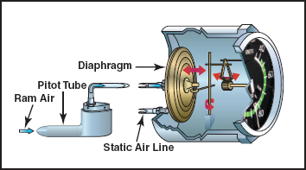
Airspeed Indicator

Slide 40
Airspeed Indicator
Indicated Airspeed (IAS)
Airspeed reading on instrument
Calibrated Airspeed (CAS)
IAS corrected for installation and instrument errors
Equivalent Airspeed (EAS)
CAS corrected for adiabatic compressible flow at a particular altitude. (more significant to high speed aircraft)
True Airspeed (TAS)
Actual speed your airplane moves through undisturbed air.
As density altitude increases, true airspeed increases for a given CAS.
Mach
Ratio of the aircraft’s TAS to the speed of sound

Slide 41
ALTIMETER
0
9
1
8
2
29.90
30.00
30.10
7
3
6
4
5
PHAK 8-3

Slide 42
Altimeter
Required for both VFR and IFR flight
Provides both direct indication of altitude control
Sensitive altimeter – adjustable for barometric pressure
How it works…
Main component is a stack of three aneroid wafers that expand and contract as atmospheric pressure from the static source changes
Mechanical linkage moves the pointer on the instrument as a result of the expanding and contracting aneroid wafers

Slide 43
Pressure Measurements
Aneroid Wafers/Cells
Acts a barometer
Wafers/cells expand or contact as atmospheric pressure changes
Wafers expand as altitude increase and contract as altitude decrease

Slide 44
Altimeter

Slide 45
Altimeter
Types of Altitude –
Indicated Altitude
Altitude read on the altimeter
Pressure Altitude
Altitude read on your altimeter is adjusted to indicate height above the Standard Datum Plane (29.92” of Hg)
Important as a basis for determining aircraft performance
Density Altitude
Pressure altitude corrected for non-standard temperature
Absolute Altitude
Height above the surface
True Altitude
True height above sea level

Slide 46
Altimeter
Altimeter settings…
Extremely important for IFR flight
At field elevation with current altimeter setting, altitude should be within 75 feet
En route, use most current settings along route of flight. (ATC will generally advise during IFR flight)
At destination, altimeter setting is critical (Always listen to ATIS, ASOS, AWOS, etc.)
If you fly from area of high pressure to an area of low pressure without resetting your altimeter, your altitude will be lower than actual (High to low, look out below!)
Non-standard temperature…
When air temperature is warmer than standard, the altimeter will indicate a lower altitude than that actually flown
When temperature is colder than standard, true altitude will be lower than indicated altitude

Slide 47
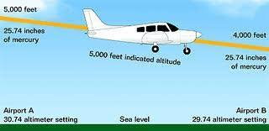
High to Low Lookout Below!!

Slide 48
VERTICAL SPEED INDICATOR
10
15
5
VERTICAL SPEED
0
20
100 FEET PER MINUTE
5
PHAK 8-7
10
15

Slide 49
Vertical Speed Indicator
Provides rate-of-climb and trend information
Can be erroneous during sudden or abrupt changes in aircraft control
Indication may lag due to its operation
How it works…
Operates from the static source
Instrument senses a differential in pressure through a calibrated leak
A diaphragm expands or contracts during a change in the static pressure causing movement of the mechanical linkage

Slide 50
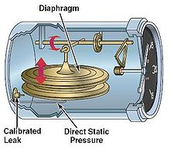
Vertical Speed Indicator (VSI)

Slide 51
Pitot-Static Instruments
System Errors:
Usually very reliable
Blockage may be caused by ice, insects, dirt, etc
Always check pitot tube and static vents prior to flight
When operating in visible moisture, always use pitot heat (if equipped)

Slide 52
PHAK 8-10
Pitot Blockage
Airspeed indicator is the
only instrument affected
by a pitot tube blockage.
A/S
VSI
ALT
STATIC PORT
ALT STATIC AIR PULL ON
DRAIN OPENING
PITOT TUBE

Slide 53
Pitot Blockage
DRAIN OPENING
If ram air inlet is clogged and the drain opening remains opened, the pressure in the line to the airspeed indicator will vent out the drain hole
Airspeed indicator drops to zero

Slide 54
Pitot Blockage
DRAIN OPENING
If both the ram air inlet and drain opening becomes clogged, the air
pressure becomes trapped inside
Airspeed indicator remains at its present position
If static vent remains open, airspeed indicator becomes an altimeter
Airspeed will increase when climbing and decrease when
descending

Slide 55
Static Blockage
All pitot-static instrument becomes affected when static port is blocked.
A/S
VSI
ALT
STATIC PORT
ALT STATIC AIR PULL ON
DRAIN OPENING
PITOT TUBE

Slide 56
Static Blockage
Airspeed will show incorrect reading
Even though ram air is still being supplied, the static pressure remains the same
Therefore, at a higher altitude, the airspeed will read lower than actual
At a lower altitude, the airspeed indicated will be faster than actual
A/S
VSI
ALT
STATIC PORT
ALT STATIC AIR PULL ON
DRAIN OPENING
PITOT TUBE

Slide 57
Static Blockage
The VSI will freeze at zero regardless of actual climb or descent. Its only source of pressure is from the static port
A/S
VSI
ALT
STATIC PORT
ALT STATIC AIR PULL ON
DRAIN OPENING
PITOT TUBE

Slide 58
Static Blockage
Blockage of the static port at any altitude will freeze the altimeter at that position
A/S
VSI
ALT
STATIC PORT
ALT STATIC AIR PULL ON
DRAIN OPENING
PITOT TUBE

Slide 59
Static Blockage
All pitot-static instruments are affected when static port is blocked.
A/S
VSI
ALT
STATIC PORT
ALT STATIC AIR PULL ON
DRAIN OPENING
PITOT TUBE

Slide 60
Instrument Checks
Prior to master switch on:
Check instruments with warning flags to be sure they are displayed
Prior to start
Listen for any noise which might indicate a problem in the electric gyros
Turn Coordinator
Miniature airplane level
Tube full of fluid
During taxi, ball should move to outside of turn & plane should lean in direction of the turn
Vacuum instruments need approx. 5 min. to spin up

Slide 61
Instrument Checks (cont.)
Heading Indicator
After setting to compass, verify it maintains alignment
Can precess no more than 3º in 15 minutes for IFR
Attitude Indicator
Horizon bar should tilt no more than 5º during taxi
Set bar for level attitude
Check ammeter & vacuum gauge for normal operation
Compass
Make sure it is full of fluid
During taxi, verify it swings freely & indicates known headings

Slide 62
Instrument Checks(cont.)
Airspeed Indicator
Unless facing a strong wind, it should read zero
Make sure it increases at an appropriate rate during takeoff roll
Altimeter
When set to current altimeter setting it should indicate within 75 ft. of actual elevation
VSI
Not legally required for IFR
Should note error before flight—if it does not indicate zero then note & compensate for it during flight

Slide 63
FAR 91.205
POWERED CIVIL AIRCRAFT WITH
STANDARD CATEGORY U.S.
AIRWORTHINESS CERTIFICATES:
INSTRUMENT AND EQUIPMENT
REQUIREMENTS

Slide 64
Visual Flight Rules—Day
Tachometer for each engine
Oil temperature gauge for each air-cooled engine
Magnetic direction indicator
Airspeed indicator
Temperature gauge for each liquid-cooled engine
Oil pressure gauge for each engine using pressure system
Fuel gauge indicating the quantity of fuel in each tank
Landing gear position indicator, if it has retractable gear
Altimeter
Manifold pressure gauge for each altitude engine
Emergency Locator Transmitter
Safety belt with an approved metal-to-metal latching device for each occupant 2 years of age or older. Shoulder harness for each front seat (A/C after 1978)
Anti-collision light system (aviation red or white)—certificated after 3/11/96
Floatation gear for each occupant if operated for hire over water beyond power off gliding distance of shore
Memory Aid: TOMATO FLAMES

Slide 65
Visual Flight Rules (Night)
Instruments and equipment specified for VFR Day plus:
Fuses (spare set), or 3 spare fuses of each kind
Landing light (if operated for hire)
Anti-collision light system (aviation red or white)
Position lights
Source (adequate) of electrical energy
Memory Aid: FLAPS

Slide 66
V-Speeds
Vso—stall speed in the landing configuration
Vs₁--stall speed in a specified configuration
Vx—best angle of climb speed
Vy—best rate of climb speed
Vfe—maximum flap extended speed
Vlo/le—maximum gear operating/extended speed
Vno—maximum structural cruising speed
Vne—never exceed speed
Va—max speed at which full aerodynamic control will not
overstress the airplane
Vr—rotation speed

Slide 67
Gleim Questions: Sections 2.1-2.8

